Slide 1
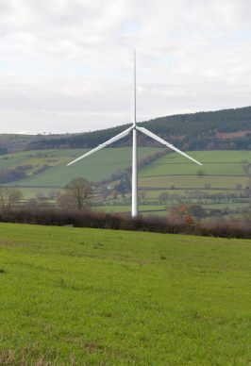
Bishop’s Castle Community Wind Energy Project
Wind Turbine Update
14th September 2026

Slide 2
Why Wind?
The global context is increasingly concerning - fossil fuel use causes
- Extreme weather (heat and flooding), fire risks, crop failures
- Conflicts and wars over oil (which further increase prices)
We must end our dependence: switch to renewable energy.
Wind: lowest cost, most effective and most efficient generator
- Generation cost: 3-10p per kWh unit at scale. The cheapest!
- All-year round, day & night generation
- Wind uses 10x less land than solar per unit generated
Wind is the way forwards for generation at scale.
Solar is best suited to rooftops…

Slide 3
Why community-run? Why here?
Community-run energy returns over 30x community benefit vs commercial!
Lower-cost electricity offered to local customers
The asset is for the benefit of the community, not shareholders
We expect £ millions return to the community over 25 years
Our low location balances energy generation with minimal visual impact
Local generation is most efficient and resilient for the network
Avoiding the need for more pylons
More energy available locally for EVs and heat pumps
Bishop’s Castle is leading the way in England!

Slide 4
Why is it taking so long?
Actually, 5 years is not long for a community energy project!
…and lots of things beyond our control keep changing, e.g:
The cost of key components or works
Prices we can expect to get on the energy markets
Regulations on who we can sell to, and how
Which turbines are available
Constraints from the grid
The majority of projects fail - we keep adapting and are determined to get there!

Slide 5
What have we done in the last year?
June 25: planning permission was granted for a 1MW wind turbine
    80m tip height, 60m diameter
Sept 25: we consulted on pushing ahead as a stand-alone wind project
Since then, with support from STCE & the Midlands Net Zero Hub, we have:
tried to arrange a connection via SpArC (not possible)
worked out the planned turbine isn’t viable without the SpArC connection
asked Shropshire Council for an amendment to put the turbine on a taller tower
but were told we would have to put in a new application…
Notes:
Geraint hands over to dave?

Slide 6
What have we done in the last year?
We have reviewed options, including choice of site & turbine
We are now proposing a 2MW turbine, with 110m tip height and 90m diameter
            Slightly south west of the previous location
            With an Energy Club so we can sell electricity locally at a discount
                We have applied to register LCE as a Community Benefit Society
                And have been applying for government funding
Notes:
Geraint hands over to dave?

Slide 7
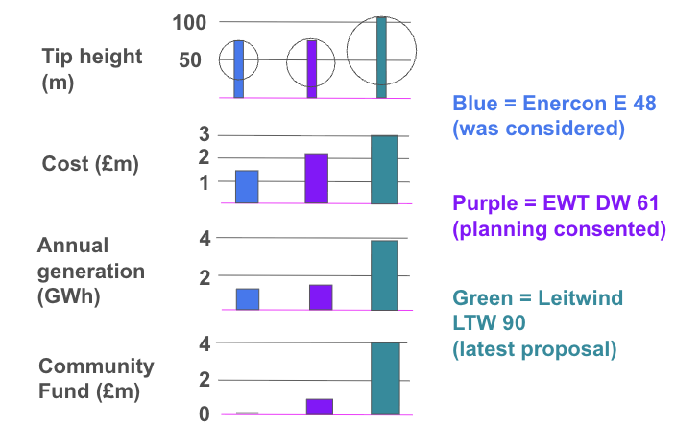
Size matters - more than you’d think!
Notes:
Extra generation = increased climate impact & better viability. CF is estimated, depends on us getting a 2MW upgrade, will start in earnest after 10 years and is allowing for inflation (circa £2M at todays prices)

Slide 8
Size matters - more than you’d think!
4 GWh/year = 4,000,000 kWh/year
Average household consumption is 3,000kWh/year
So that’s enough for 1,333 households!
(the whole of STCE’s Twemlows solar farm only produces 10GWh/ year and that covers 58 acres, plus wind electricity is generated when it’s more useful)
Notes:
Extra generation = increased climate impact & better viability. CF is estimated, depends on us getting a 2MW upgrade, will start in earnest after 10 years and is allowing for inflation (circa £2M at todays prices)

Slide 9
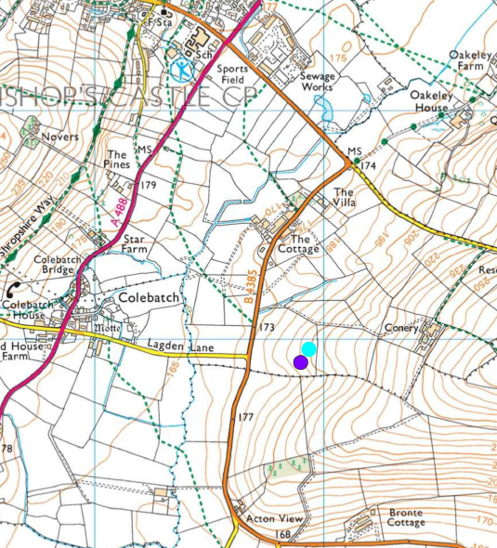

Slide 10
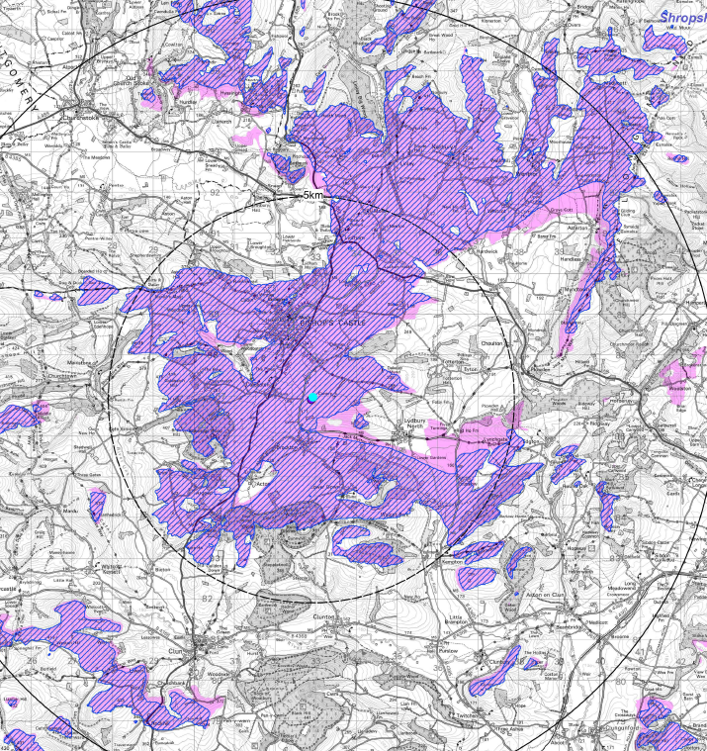

Notes:
Doesn’t allow for trees etc

Slide 11
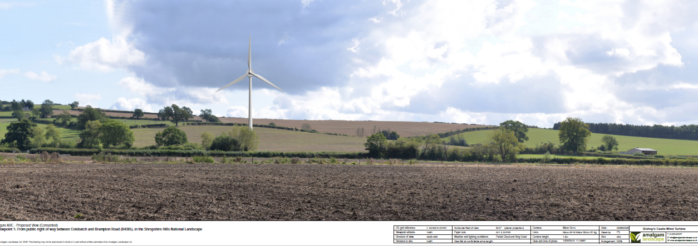
‘Existing’ 1 MW turbine from footpath from Colebatch to Brampton Road

Slide 12
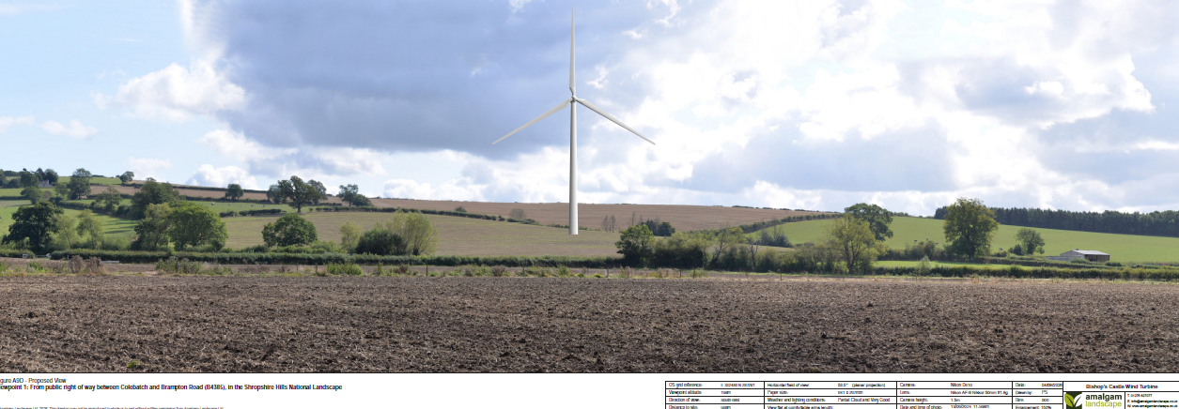
Same view of proposed 2MW turbine

Slide 13
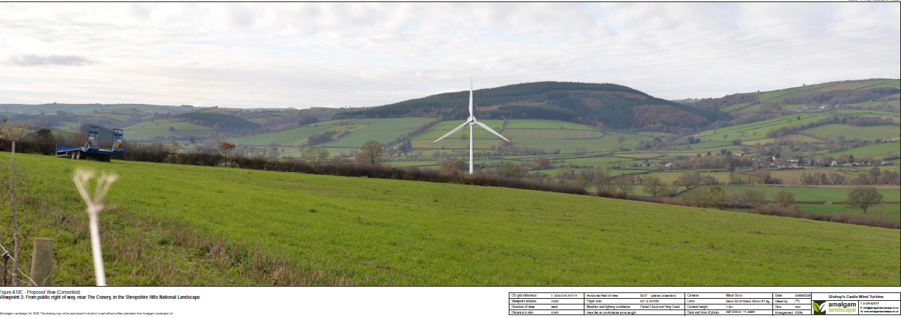
‘Existing’ 1MW turbine from footpath near the Conery

Slide 14
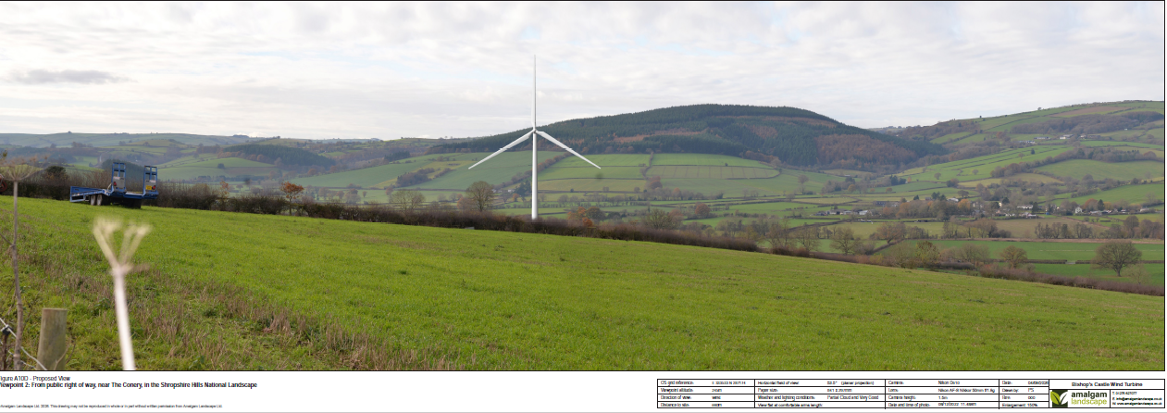
Proposed 2MW turbine from same viewpoint

Slide 15
Energy Club
Energy Club: local residents, businesses and organisations can buy electricity at a discount.
Two ways to do this: one limited to the local substation area, the other over a wider area.
Can’t recommend which route to take yet: situation may change in 2 years time.
Aiming for at least 10% discount, hopefully more.
Club will be separate to the LCE CBS, but connected.
You can belong to either or both: shareholders in LCE and Club members are different groups.
There is considerable interest already in joining the Club.
Similar clubs already set up in England & Wales, but none with a 2MW wind turbine!

Slide 16
What Next?
Lighfoot Community Energy to register as a Community Benefit Society
We will submit a new planning application mid October
Get new noise and shadow flicker reports,
Update our ecology and heritage reports
Check we can get the longer blades to site
Amend our main submission document
and raise more development funds, applying to Great British Energy
Once planning is granted we can put in an official application to connect to the grid
Then we raise the £3m build costs! Some grant, some loan, some shares
We aim to issue a share offer mid 2027 and be on site early 2028
Notes:
Still supported by STCE, DG to join LCE as a director

Slide 17
How you can help, please…
Join our mailing list if you’re not on it already
Talk to people who haven’t come tonight
Support the planning application once it’s live
Register interest to join the Energy Club
Consider joining the LCE board
Invest when we issue shares
Notes:
Messages of support on SC portal particularly useful..

Slide 18
Thank you for supporting us!
Any further questions?

