Slide 1
Bishop’s Castle Heat & Wind Project
Wind turbine details
The wind turbine montages have been prepared by Amalgam Landscape using viewpoints agreed with Shropshire Council

Slide 2
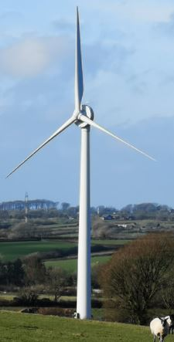
We are interested in a 1MW turbine that would be around 54m to the hub
(80m to the tip).
A wind constraint study identified two possible sites to the east of the town
We have settled on the site W of the Conery just off the B4385 to Lydbury North
A turbine could potentially work in this locations as we could turn every unit of electricity generated into 3 or 4 units of heat by feeding it to the heat network air source heat pumps.

Slide 3
Ecology studies for this site are being completed, nothing crucial has been found so far.
Telecoms studies show we are just outside the clearance area for a microwave link
Noise studies should be completed soon but we are well clear of residential buildings.
A heritage study will be included in the planning application.
The planning application should be submitted late Oct/early Nov 2024.

Slide 4
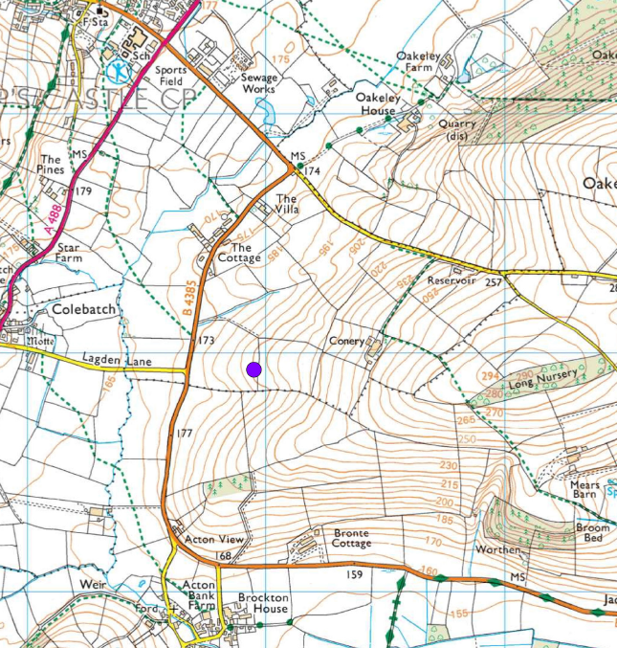

Slide 5
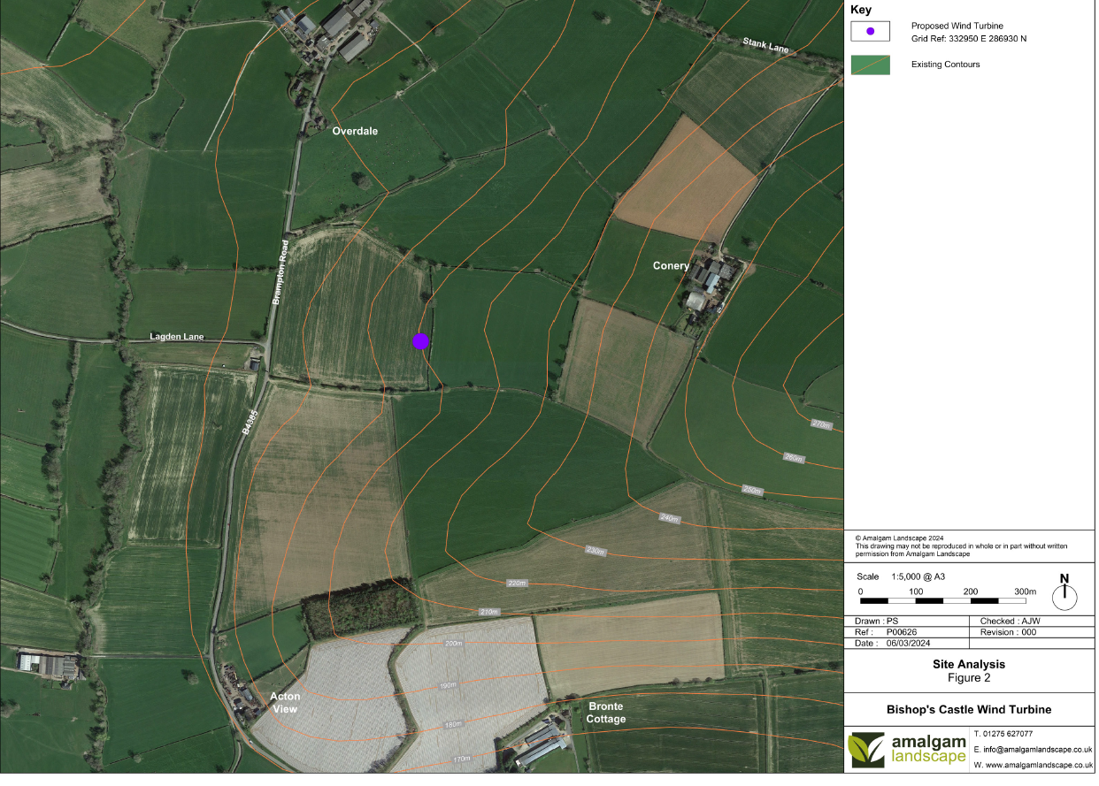

Slide 6
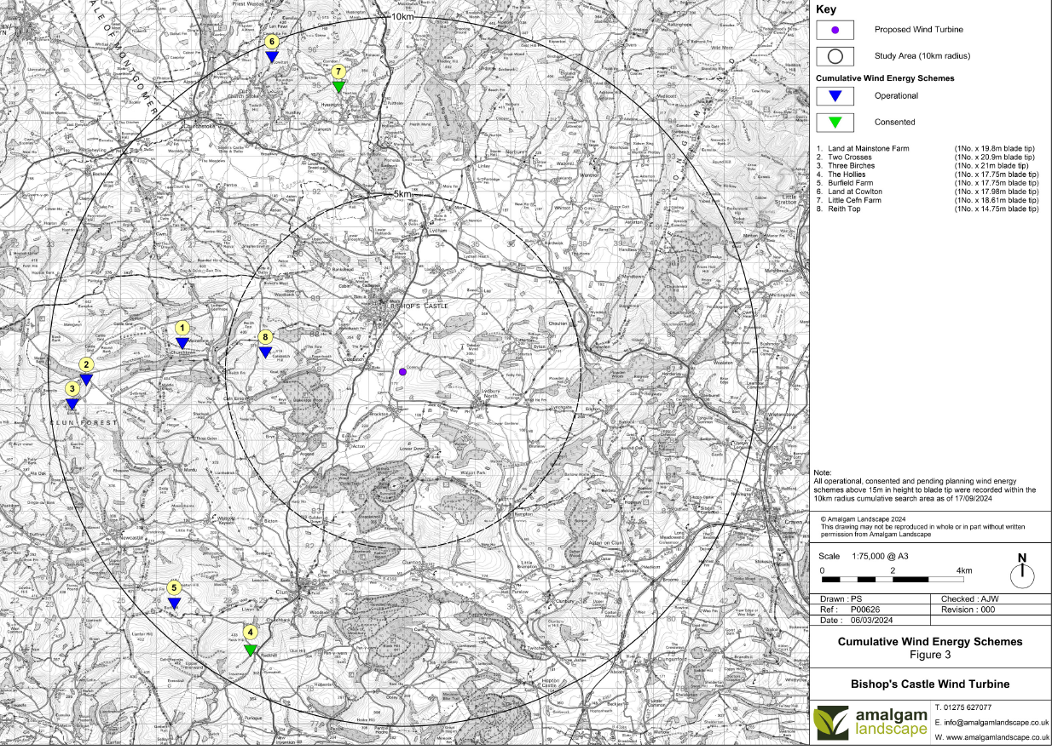

Slide 7
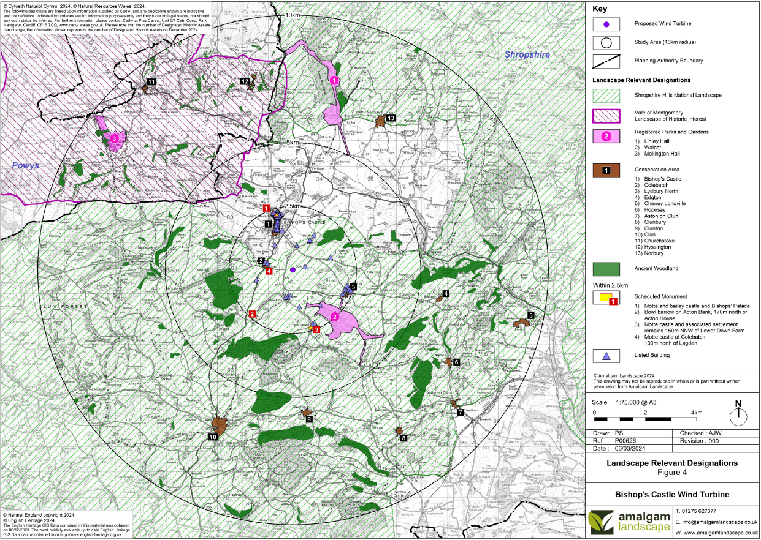

Slide 8
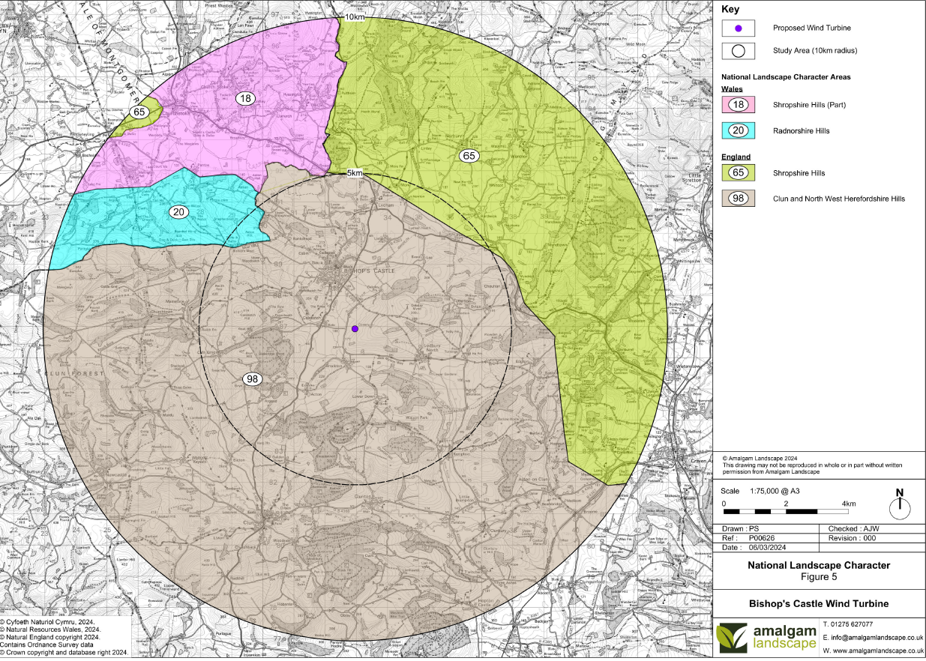

Slide 9
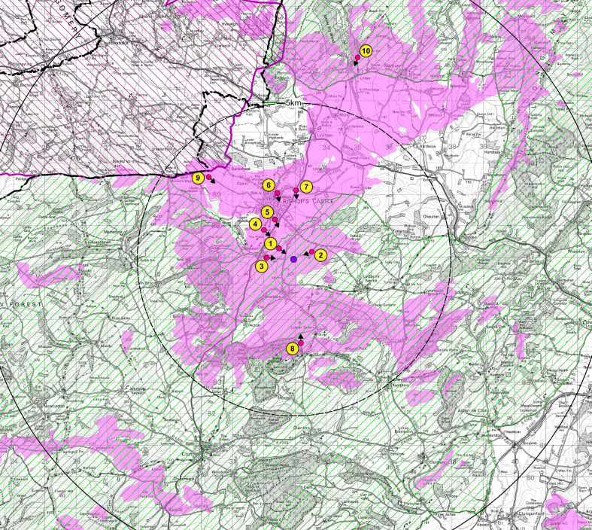
The turbine tip might be visible from the areas marked in pink,
but this does not take into account trees or buildings
(the numbers are the viewpoints as shown in the following slides)

Slide 10
Viewpoint 1 From public way by Colebatch

Slide 11
Viewpoint 2 from footpath near the Conery

Slide 12
Viewpoint 3 from footpath south of Lagden Lane

Slide 13
Viewpoint 4 Shropshire Way between Colebatch & Bishop’s Castle

Slide 14
Viewpoint 5 from SpArC car park

Slide 15
Viewpoint 6 from Bull Lane

Slide 16
Viewpoint 7 from crossroads at Love Lane

Slide 17
Viewpoint 8 from footpath near Lower Down

Slide 18
Viewpoint 9 from gateway on Kerry Ridgeway
The turbine is not visible from viewpoint 10, Shropshire way to the north of BC

Slide 19
Please consider filling in the Expression of Interest for the heat network, either on paper or online,
And encourage friends, neighbours, relations to do likewise.
This will help us immensely as we move to the next phase of studies.
And when the wind turbine planning application is submitted, please do submit comments
We are also looking for extra volunteers to join the Heat & Wind working group..

Slide 20
The work on this project to date has been funded through
Shropshire & Telford Community Energy,
using grants from the Next Generation project set up by Power to Change
.
And the Community Energy Fund, run by the Midlands Net Zero Hub

Slide 21
Contact, dave@sharenergy.coop
or info@lightfootenterprises.org
www.lightfootenterprises.org
www.stcenergy.org.uk

