Slide 1
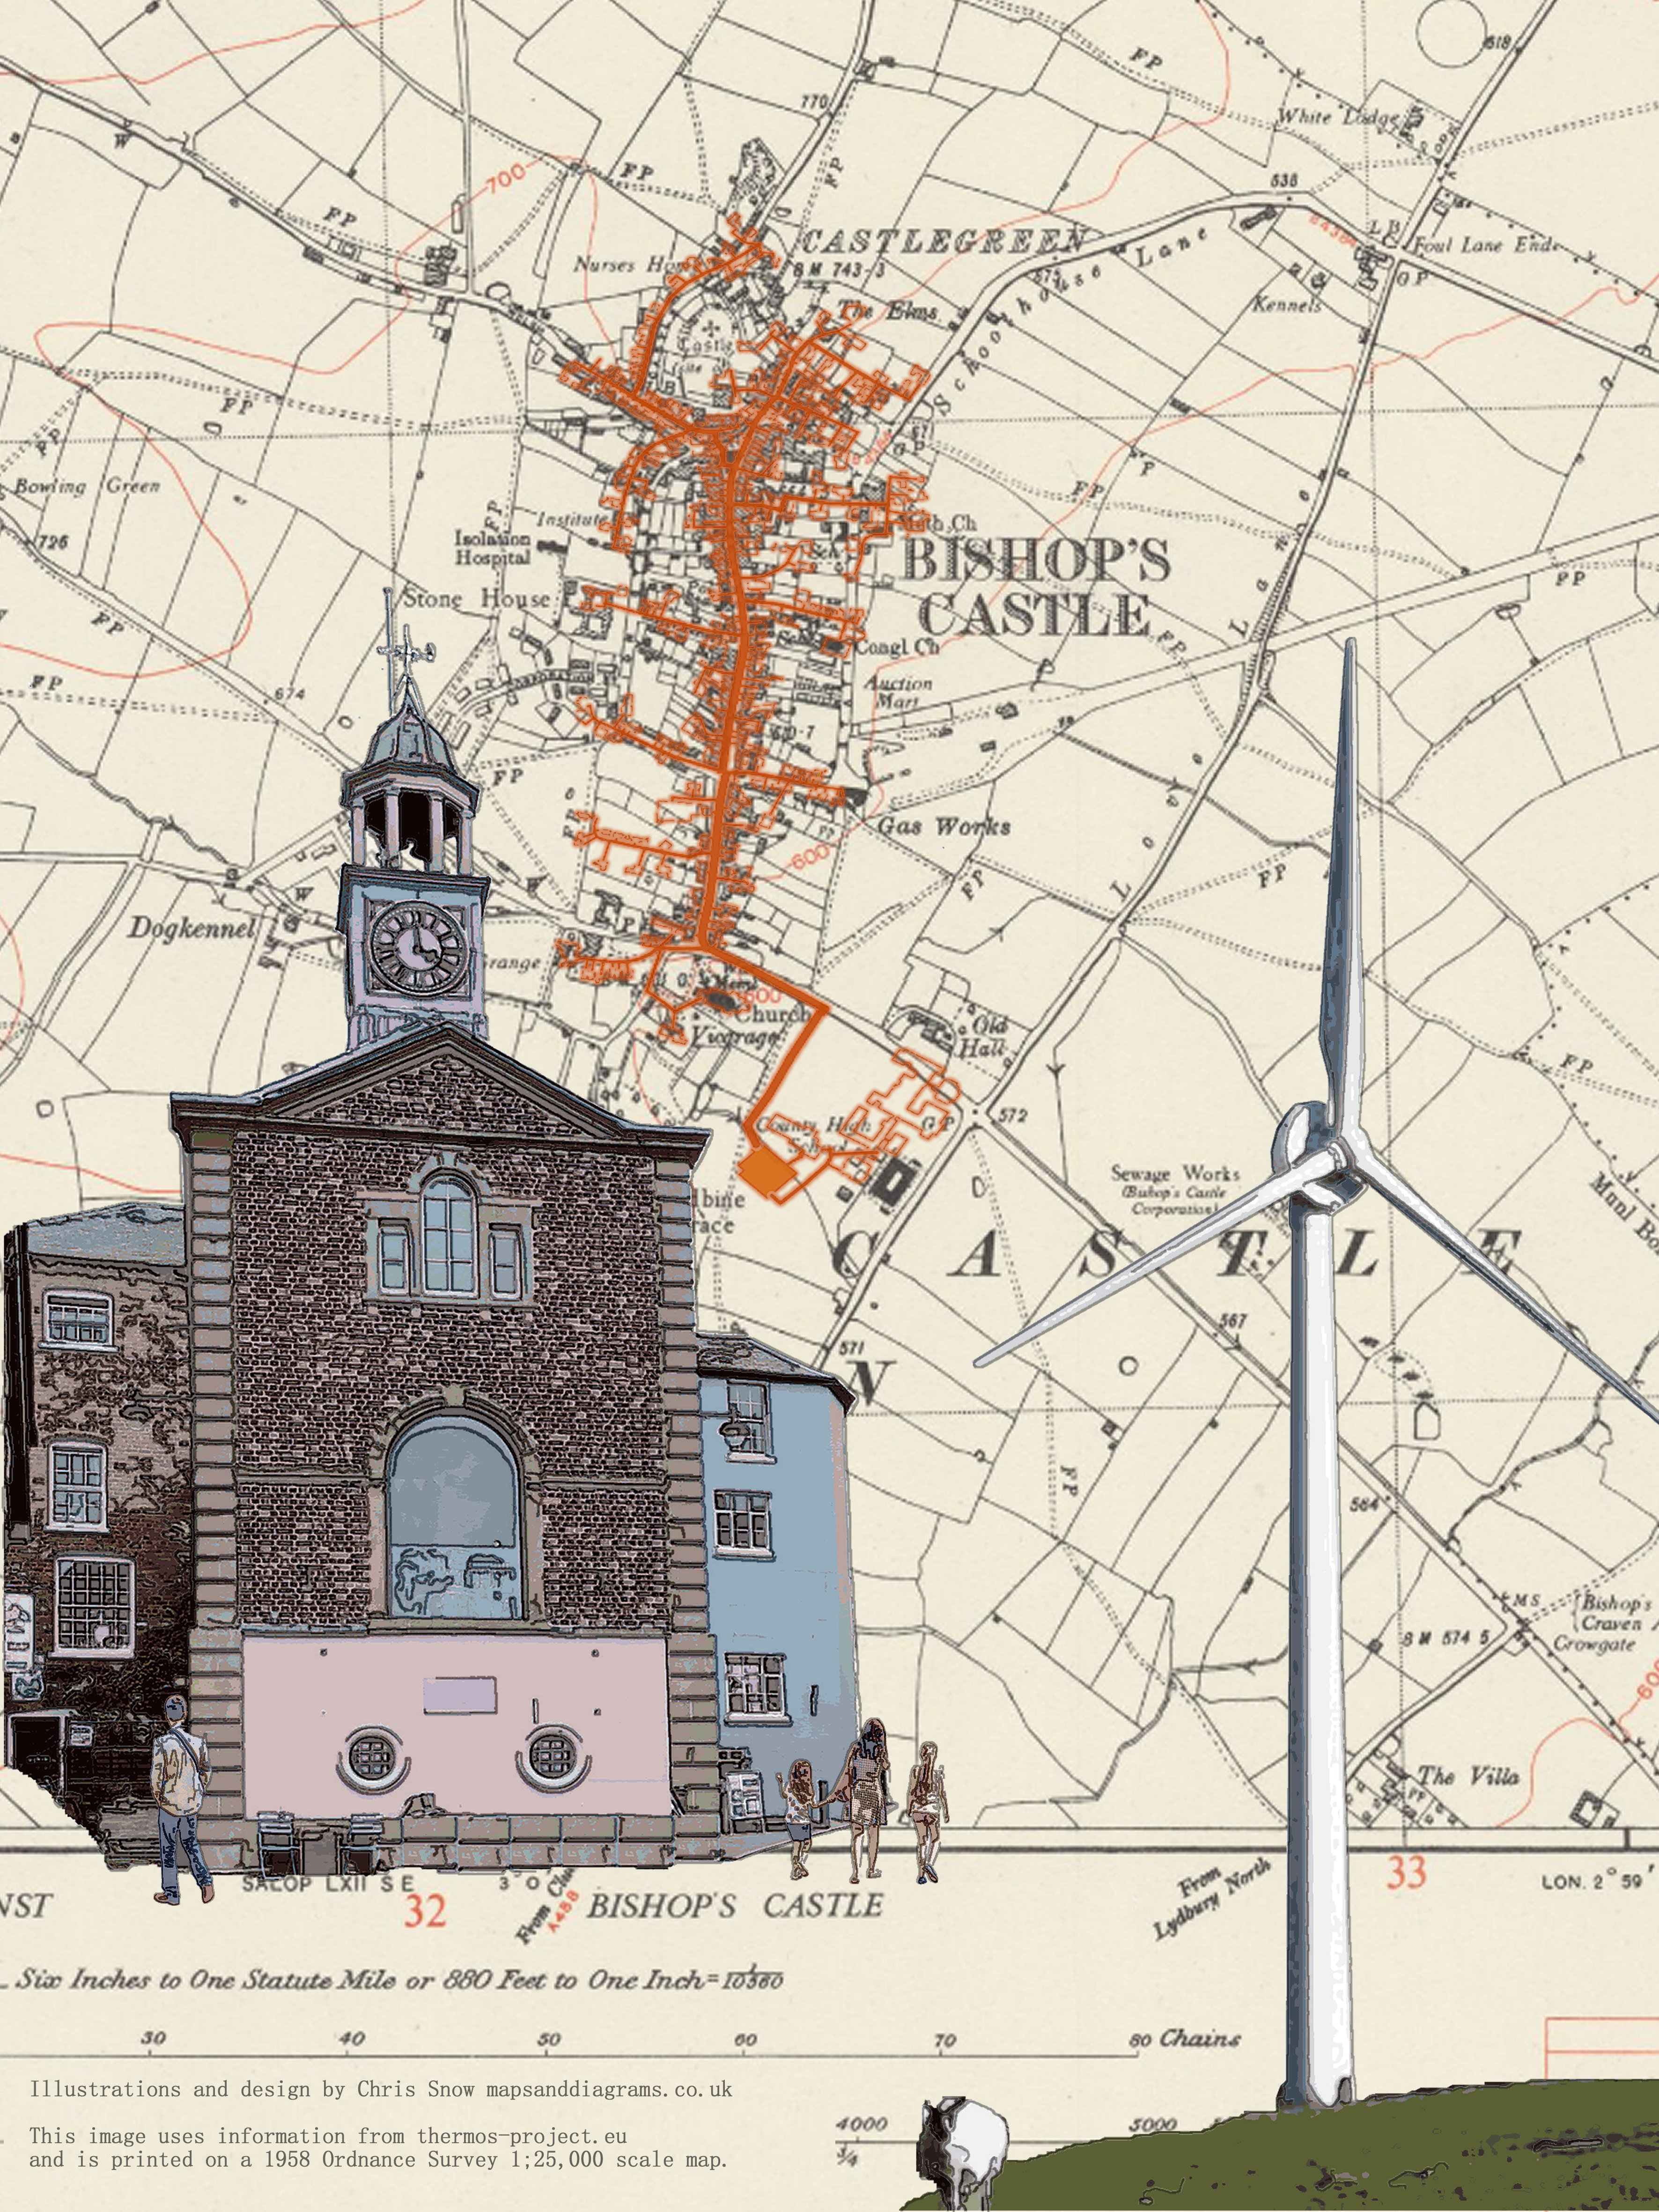
Bishop’s Castle Heat & Wind Project

Slide 2
BISHOP’S CASTLE HEAT & WIND
Martin Crane, Carbon Alternatives
Dave Green, Project Manager, Sharenergy
(& Treasurer, Shropshire & Telford Community Energy)
Dan Grierson, the Energy Workshop

Slide 3
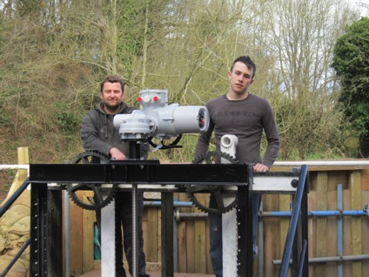
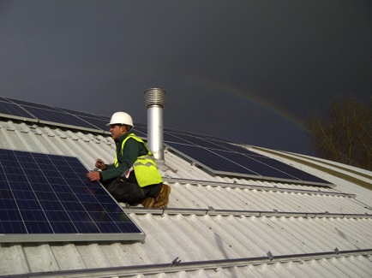
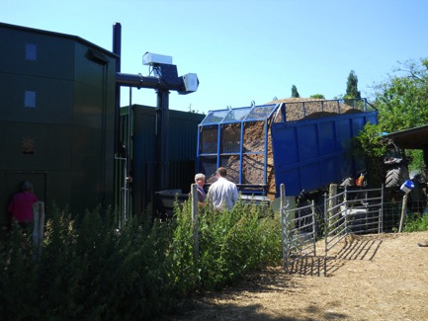
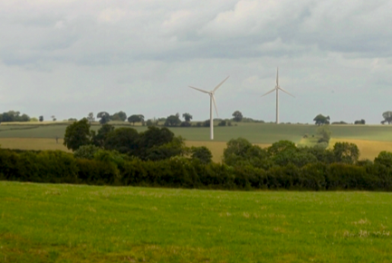
Sharenergy: a Shrewsbury-based co-operative helping people to set up renewable energy Societies across the UK
Finding projects
Setting up the Society
Business planning
Share offers
Administration

Slide 4
Martin is a self employed consultant specialising in heat network, the technical and economic aspects.
Used to work for one of the big private sector heat network operators
Very interested in community ownership and is a director of community owned Springbok Sustainable Woodheat - a small biomass heat network serving a range of retirement accommodation.

Slide 5
Shropshire & Telford Community Energy (STCE)
Is a Community Benefit Society
Which owns and runs the 10MW* Twemlows
Solar farm nr Whitchurch
* That’s 40,000 solar panels…

Slide 6
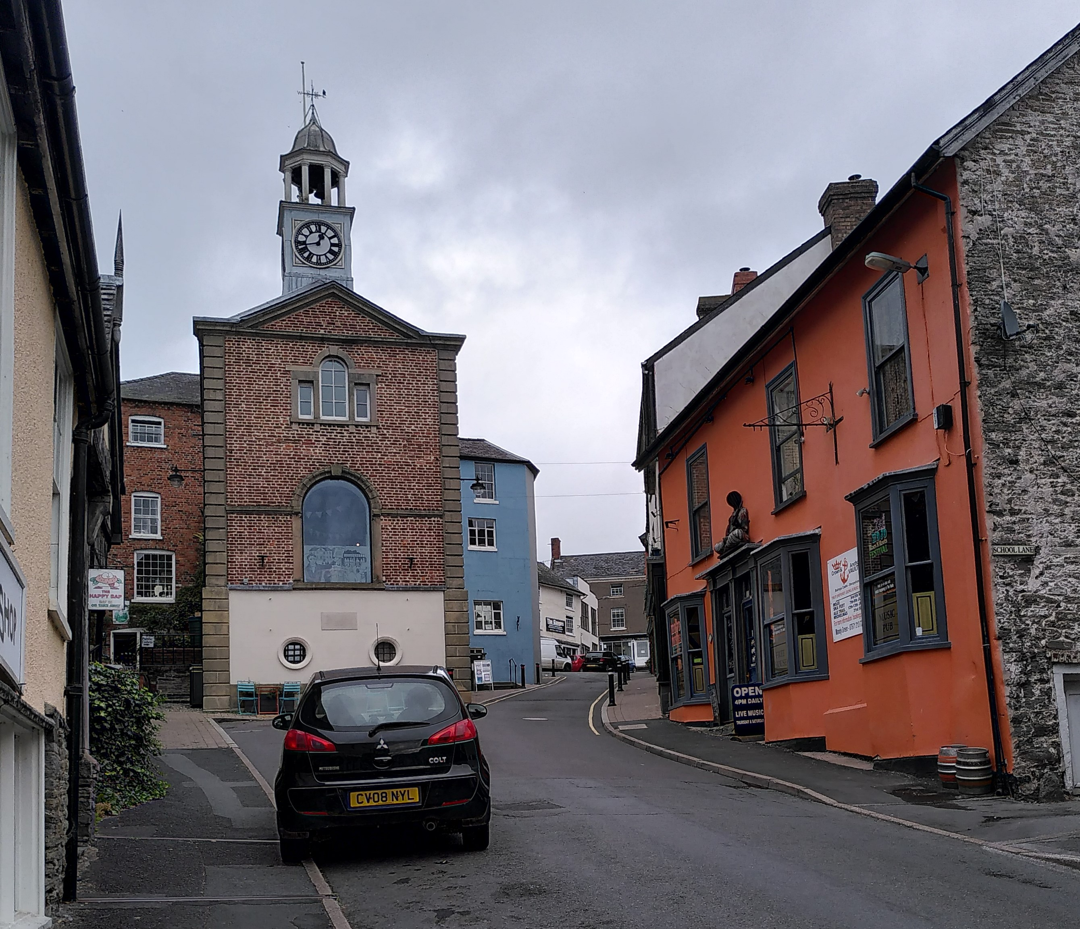
Bishop’s Castle is a fairly compact town of 600 houses, plus two schools, swimming pool, theatre etc. There is no gas grid, so most properties are heated by oil or LPG.
Much work has gone into energy efficiency and there are many properties with solar panels, but the carbon footprint is still stubbornly high.
Many of the properties are poorly suited for air source heat pumps and there is very little room for fitting ground source heat pumps.
Private Sector
Individual co-op members & other co-ops

Slide 7
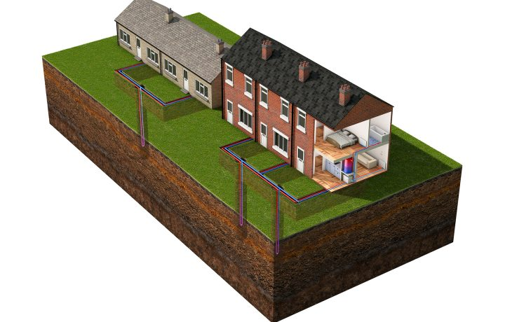
Shared loop system
Notes:
We’ve previously explored small scale shared loop systems but with the closure of the Non domestic RHI we couldn’t find a viable solution.

Slide 8
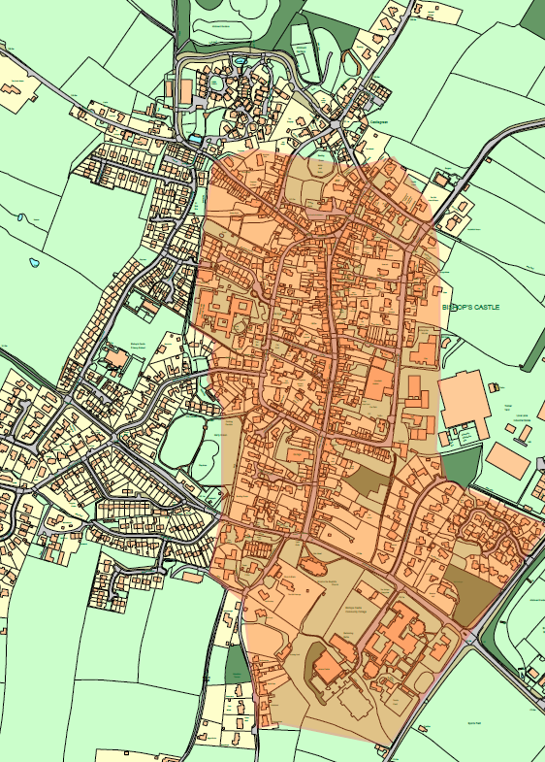
So, we started looking at a larger scale heat network, covering a minimum of 100 houses, but also potentially other buildings such as SpArC and the schools.
We’ve not included the west side of the town as there are many heat pumps there already.

Slide 9
With such a heat network people could get rid of their boilers and oil tanks.
With the heat provided from heat pumps, powered by renewable energy,
the carbon savings are enormous -
around 85% initially

Slide 10
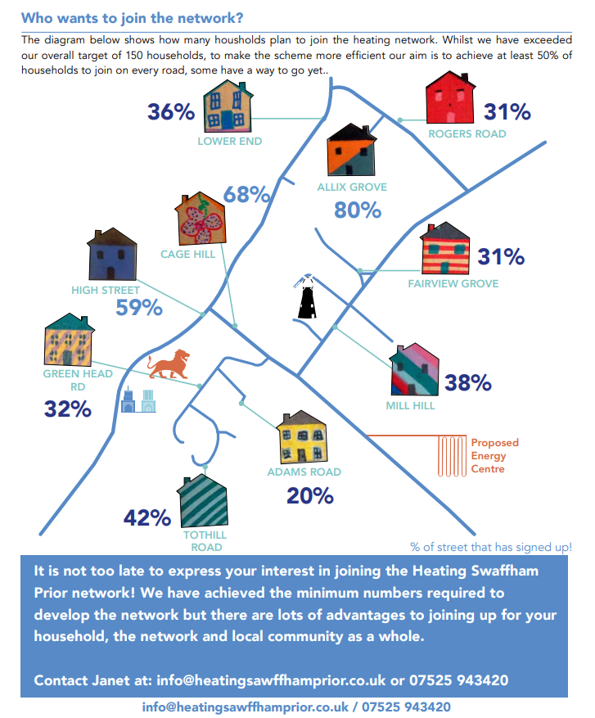
The proposal is similar to a scheme that has been constructed in Swaffham Prior, Cambridgeshire
Notes:
Delete?

Slide 11
A brief history of the BC Heat & Wind project;
We started with the idea of a heat network in 2021
STCE gained some initial grant funding which covered –
- a wind constraints study,
- an initial heat network study
- a questionnaire and a public meeting
The heat network study showed a heat network could be viable if renewable energy was used to power the heat pumps
The wind study gave two potential sites for a wind turbine

Slide 12
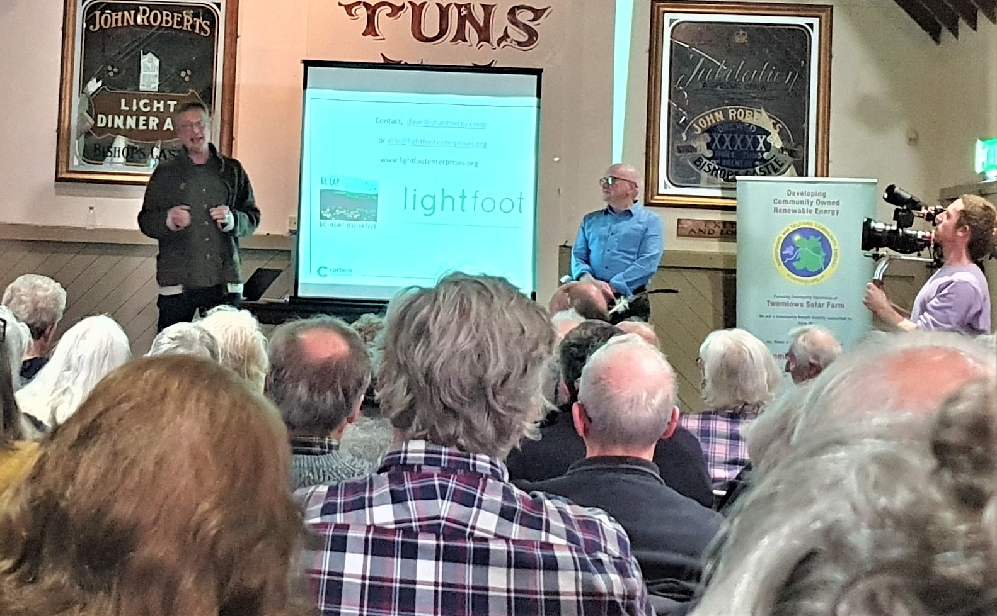
The consultations showed significant support for the project with a handful of objections, (particularly directed at the more northern site for the turbine.)
We worked for over a year to get the proposal into the Neighbourhood Plan (which was a pre-requisite for submitting a planning application for the turbine)
In April 2023 we held a packed public meeting that was filmed by Hugh Fearnley-Whittingstall for Channel 4

Slide 13
In August 2023 we were told by Shropshire Council that they would accept an application if the scheme was included in the local Place Plan, that proposal was backed by the Town Council unanimously and was agreed by Shropshire Council later that year (with the wind turbine located nr the Conery)
So, we now had permission to ask for permission for a wind turbine!
This decision opened up further funding, including a £100k successful bid to the Community Energy Fund run by the Midlands Net Zero Hub.

Slide 14
Over the last 9 months we have been working on:
Ecology studies re the wind turbine , including bat & bird surveys
Discussions with SpArC and the Community College, both of whom are keen to join the network
Case studies for 14 properties, how we would connect, how much fuel they use, what thermal improvements could be made. (we were going to do 5 or 6 but agreed to do more to satisfy the considerable interest shown)
Refining the heat network, taking into account the case studies

Slide 15
Producing the Customer Offer document
Looking at options for connecting the scheme to the grid
Completing the Landscape and Visual Impact study ( a draft was submitted with our pre-app in early 2023, the new version has more viewpoints as agreed with Shropshire Council)
Noise, telecoms and heritage studies for the turbine site
Finding a 1-hectare site for solar panels to compliment the wind turbine
Opening dialogue with Shropshire Council re laying the heat pipes.
We expect to submit a planning application for the wind turbine in early November.

Slide 16
The work on this project to date has been funded through
Shropshire & Telford Community Energy,
using their grant from the Next Generation project set up by Power to Change
.

Slide 17
Contact, dave@sharenergy.coop
or info@lightfootenterprises.org
www.lightfootenterprises.org
https://www.ethex.org.uk/invest/stce
www.stcenergy.org.uk

