Slide 1
Potential heat network and wind turbine at Bishops Castle slides on heat network only
dave@sharenergy.coop
martin@carbonalternatives.com
More Bishops Castle carbon reduction information www.lightfootenterprises.org

Slide 2
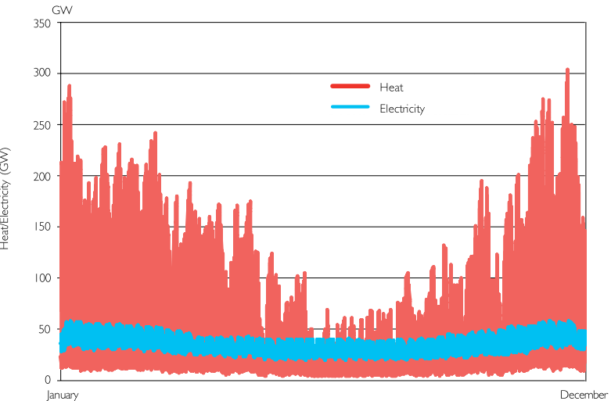
Heat accounts for ≈ 1/3 UK CO₂ emissions

Slide 3
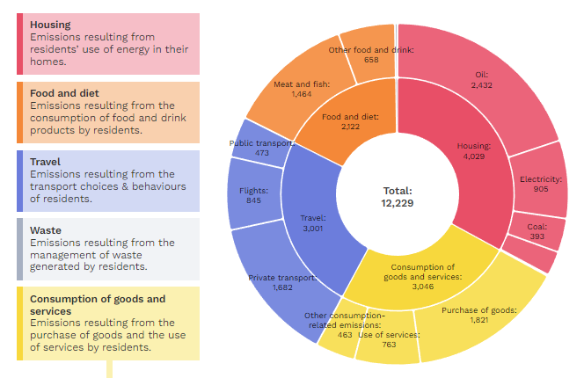
Bishops Castle tonnes CO₂ /year
Heating is 23% (significantly higher than UK average)

Slide 4
What is a heat network
Hot water supplied to each home that heats the radiators and hot tap water.
Previously ‘District Heating’
Currently supplies about 6% of UK homes
Supplies 65% of homes in Denmark
Utilises central low carbon heat source
Government estimate that to reach net zero at lowest cost heat networks will supply around 20% of UK homes

Slide 5
Why heat networks
A good solution where:
Buildings close together
Buildings have poor insulation and hard to improve
Space for an air source heat pump limited
Low cost renewable electricity available
Challenges
Pipework and installation expensive
Need a high proportion of the buildings to join to make it economic

Slide 6
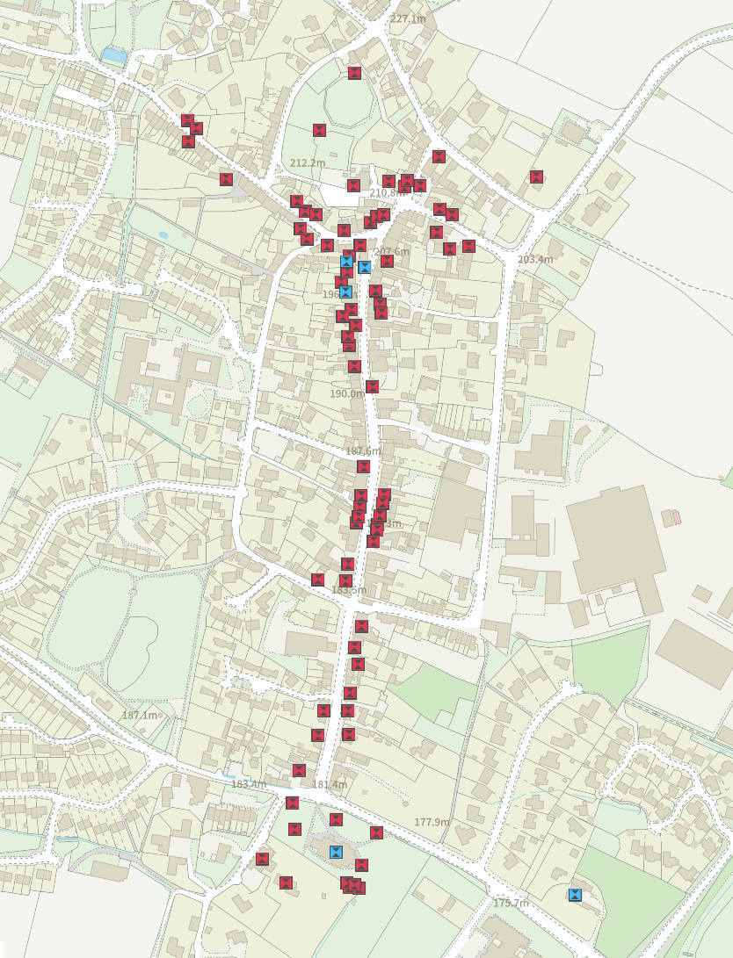
Listed buildings
Hard to insulate
Mostly solid wall so high heat demands
Adjacent building typically similar

Slide 7
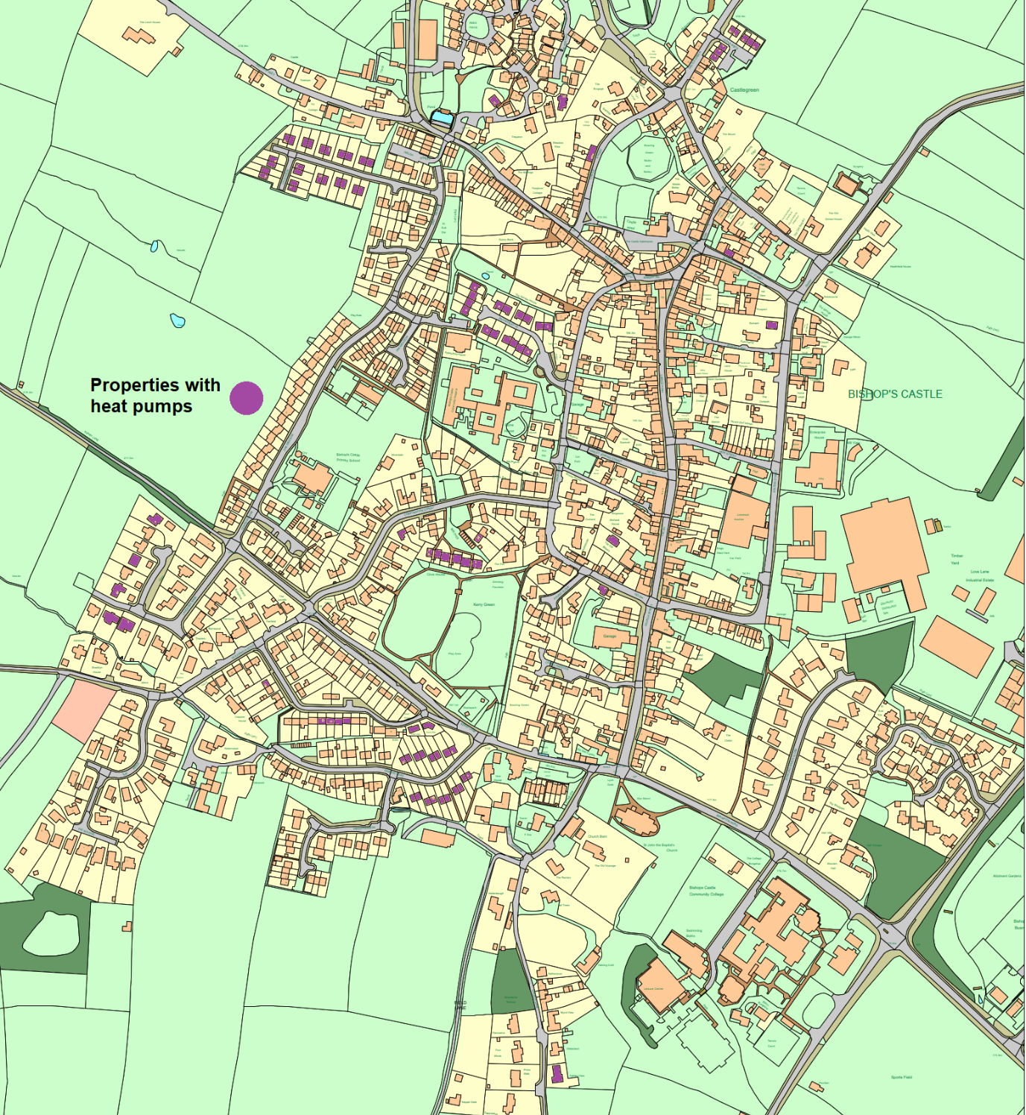
Heat pumps
Houses with heat pumps should keep them!
So we’re not currently proposing taking the network to the west side of the town as there are already a high proportion of houses with heat pumps there.

Slide 8
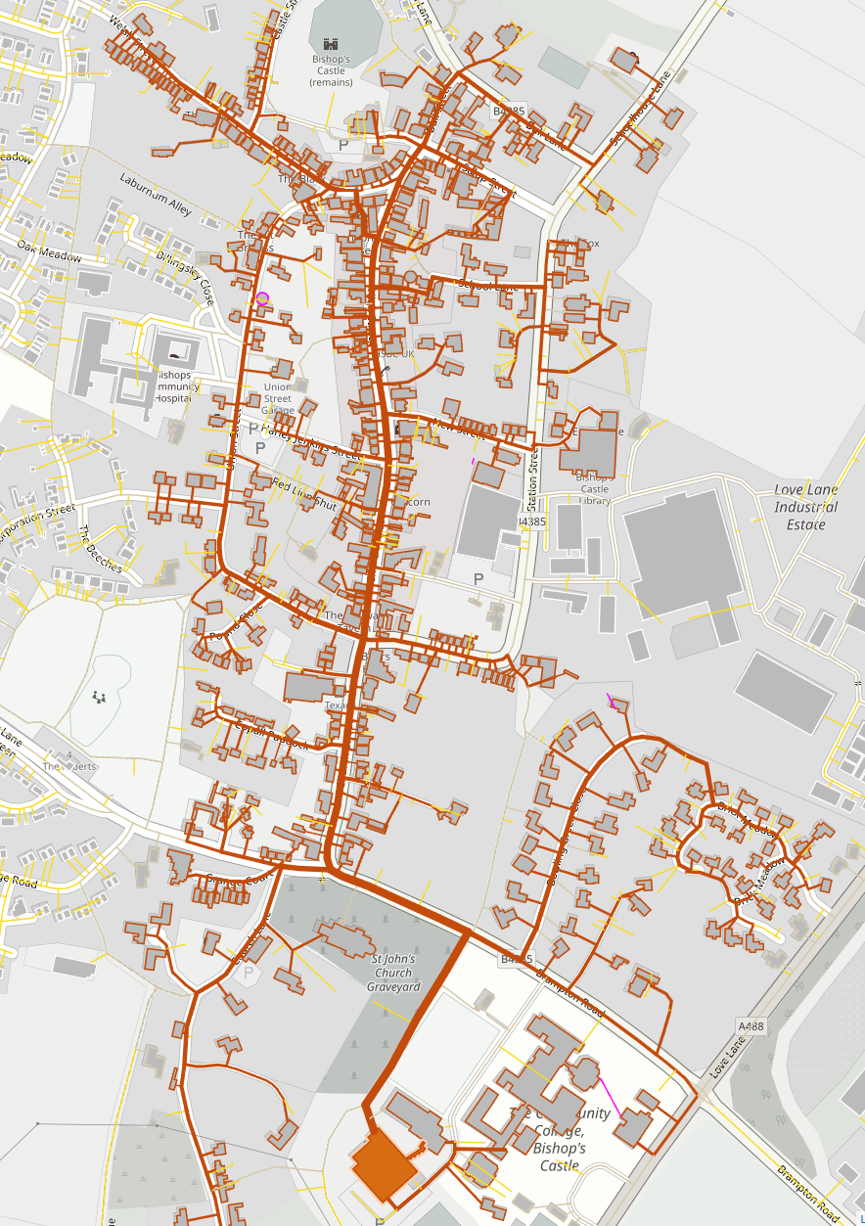
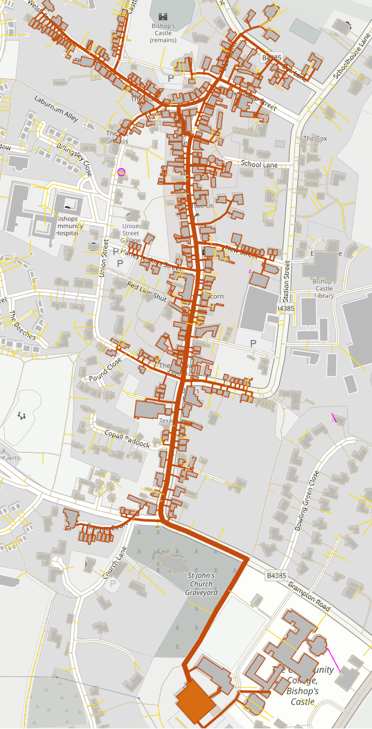
Probable maximum network
Smaller more economic network

Slide 9
Possible Heat sources:
Biomass – little spare heat at wood yard, experience is that owning and operating a biomass boiler can be labour intensive and some less supportive of biomass
Ground Source heat pump – the required boreholes very expensive
No river or lakes for water source heat pumps and there is little heat available from the sewage works.
No industrial or other waste heat sources
Air source heat pump
The heat pumps can benefit from lower cost electricity from wind turbine and solar PV.
If using heat pump PV a better option than solar thermal.
So air source heat pump chosen along with wind turbine and solar PV

Slide 10
So the proposal is:
Air source heat pump (ASHP) 750kW
Back up oil boilers, will cover peaks and if ASHP off line
1 MW wind turbine
500kW of solar PV
Thermal store 150m³ (big tank of water)
The heat pump supplies 90% of heat from ASHP
The 1MW wind turbine and 500kW PV supply most of the electricity for the heat pump (and SpArC, and College?).
More electricity is exported than imported over the course of the year.
Direct electricity sales to SpArC and the College would help the scheme economics and lower electricity costs to SpArC and the College.
1000 tonnes/yr CO₂ saved, a reduction of about 90% for heat customers
The thermal store can store up to 8 hours of heat in January and over 2 days of heat in August. The thermal store allow the heat pump to run when there is wind / solar and fill the store so there is heat when no wind or sun.

Slide 11
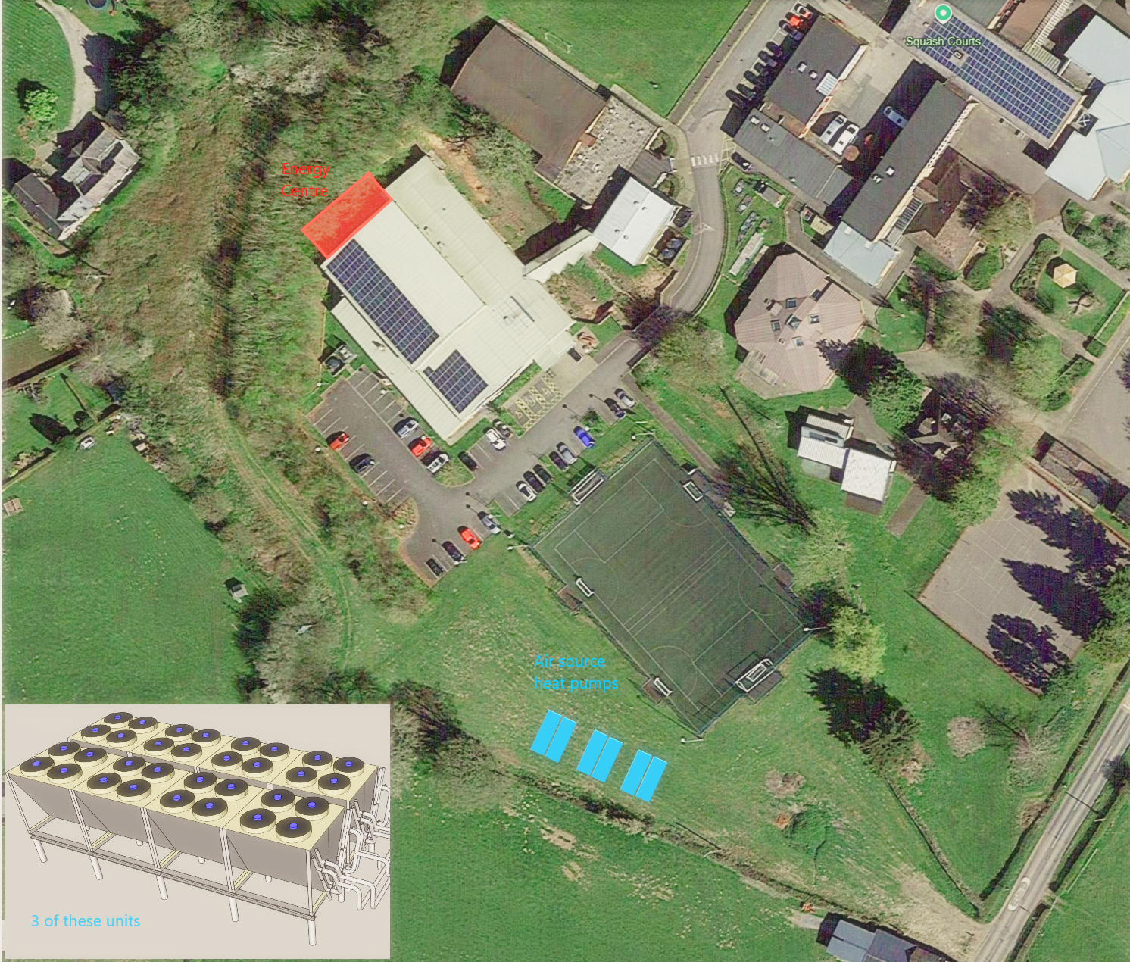
Energy centre and heat pump proposal. Currently has not been discussed with landowners!

Slide 12
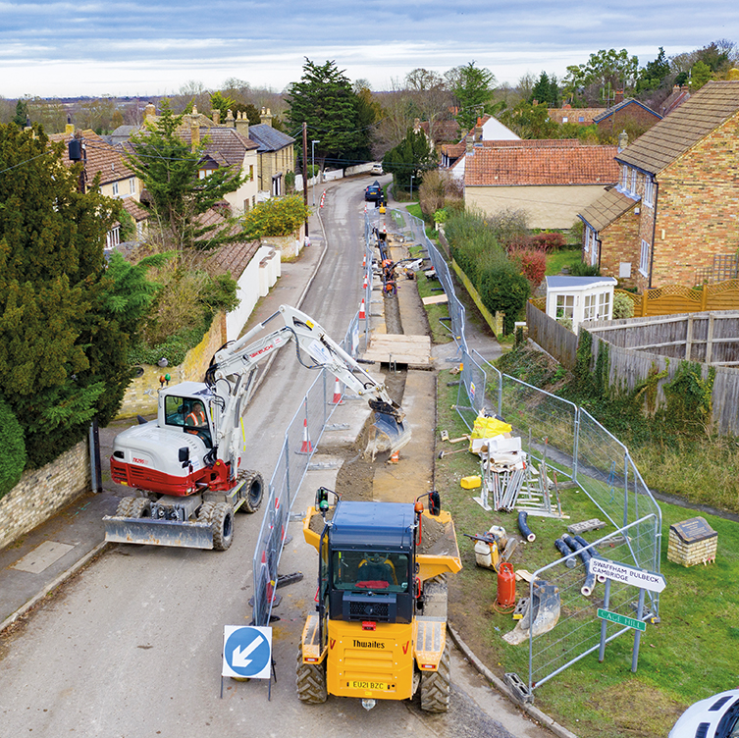
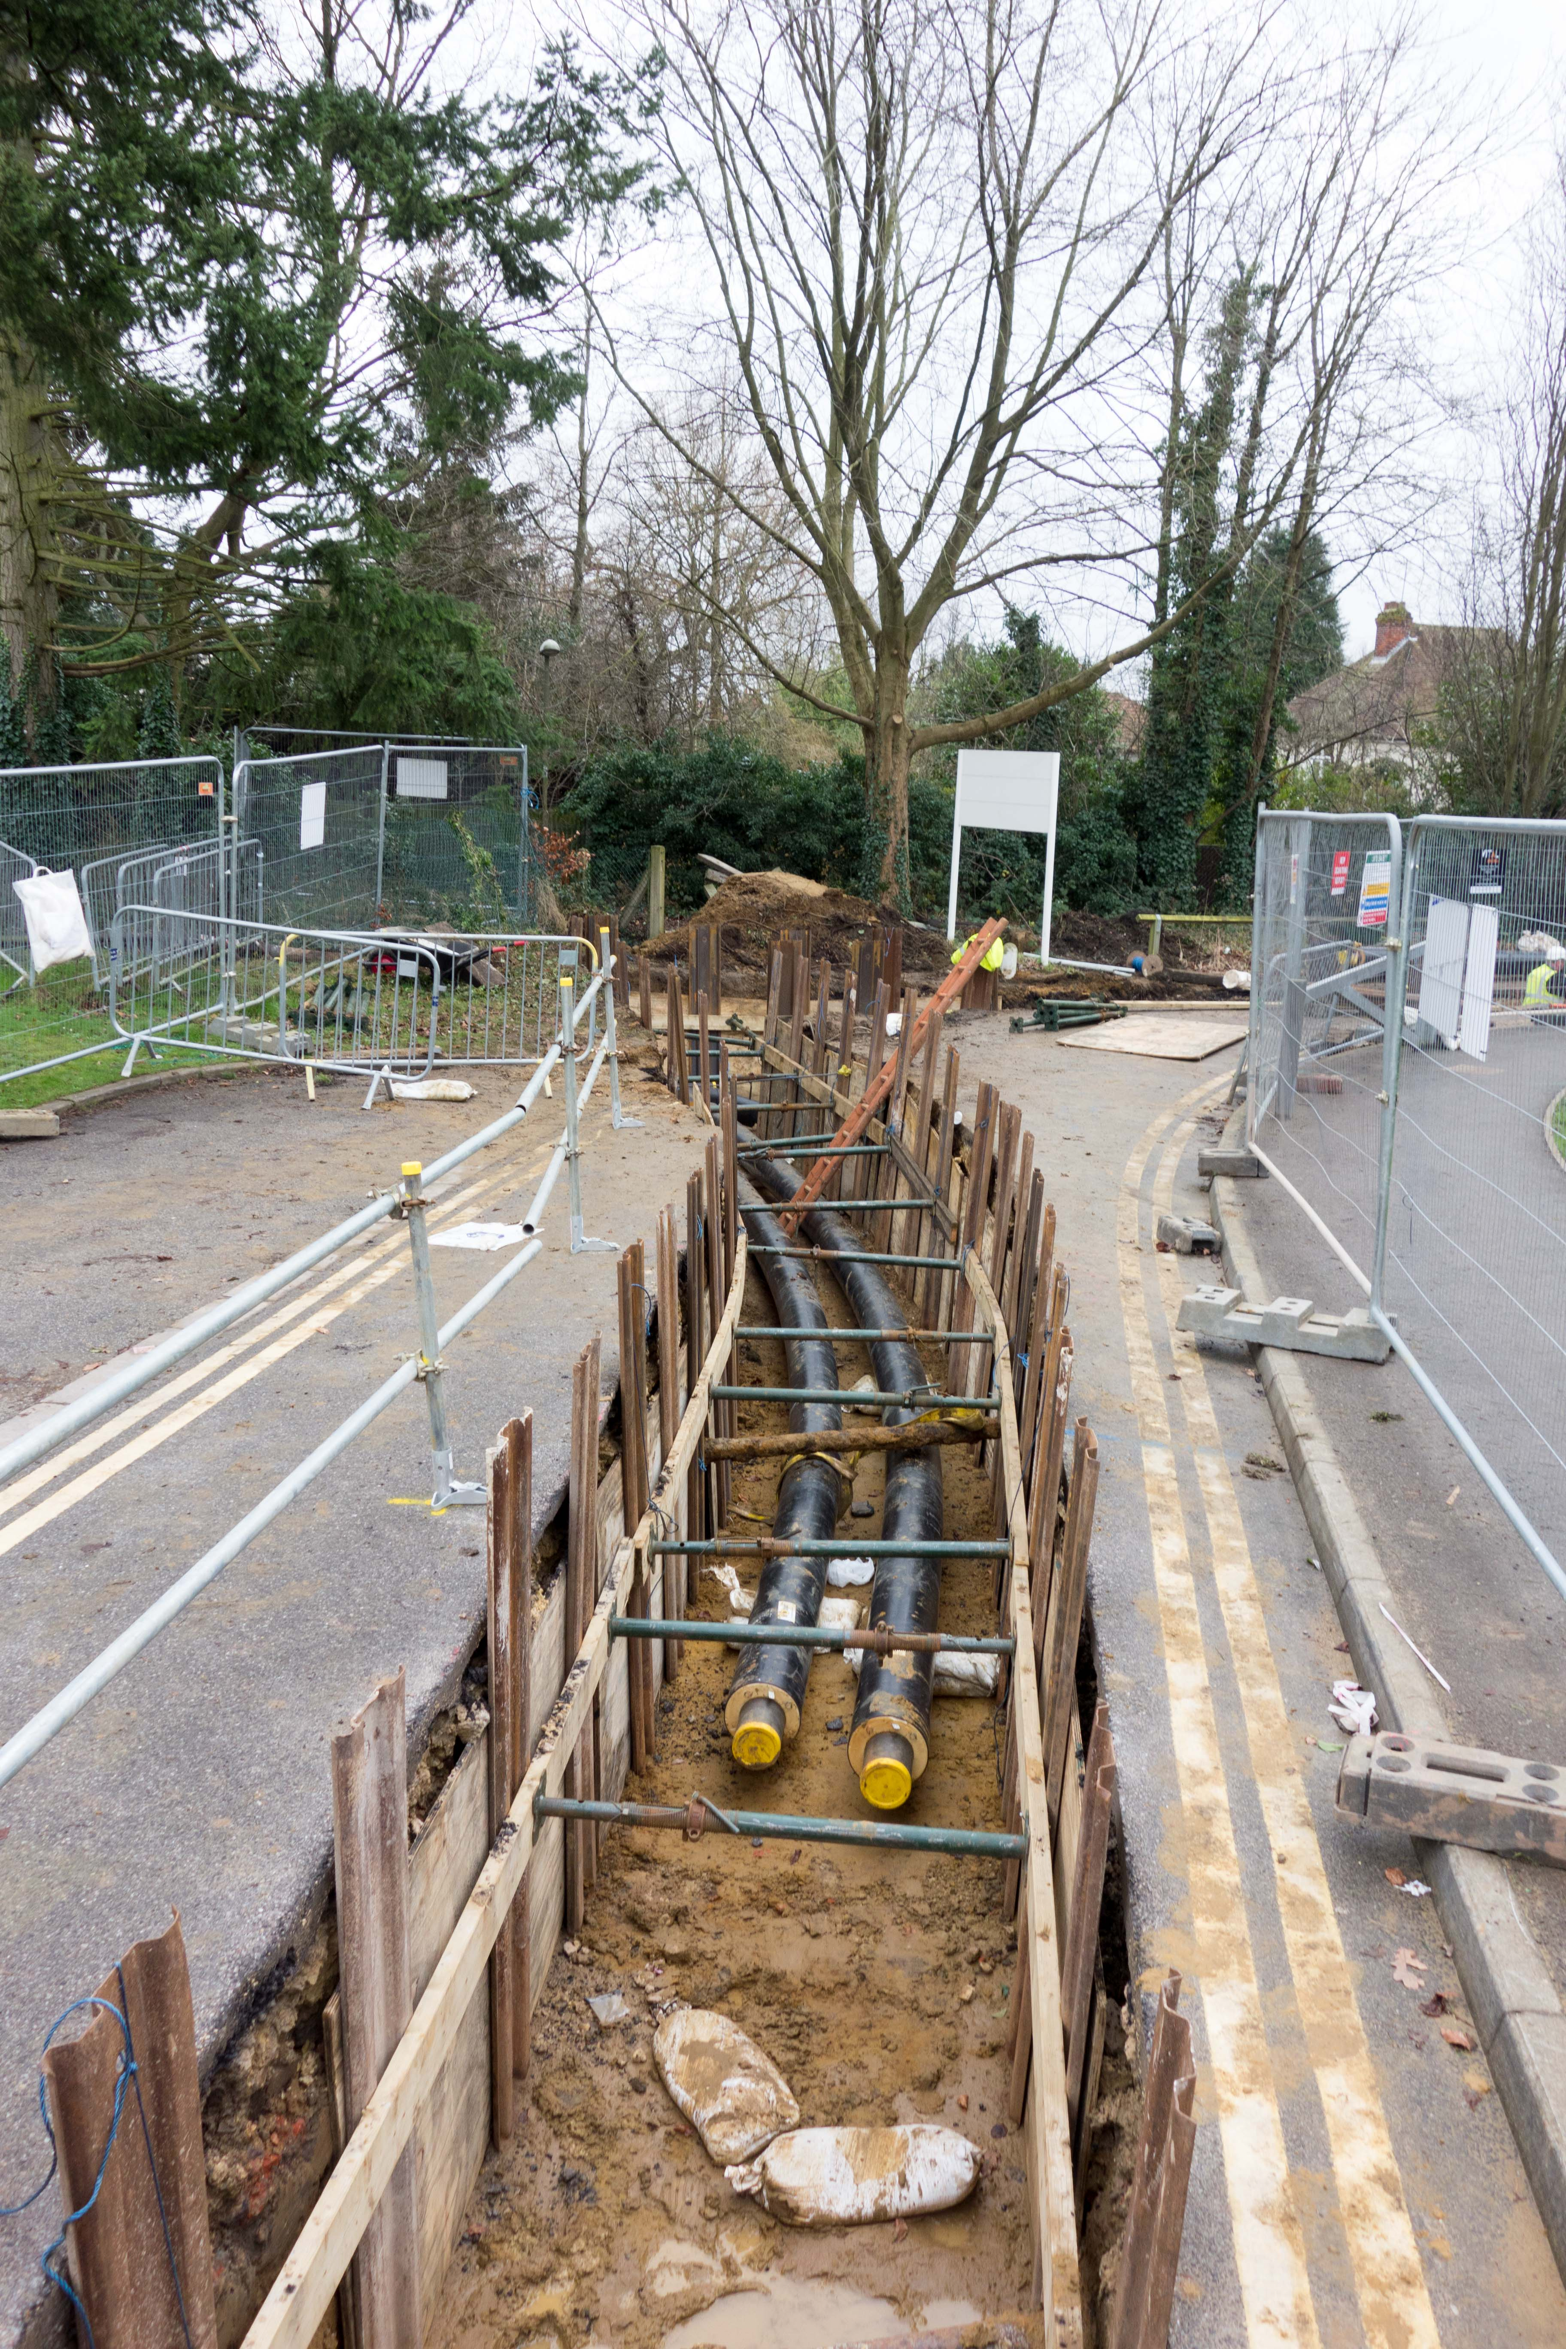
Installing the pipework

Slide 13
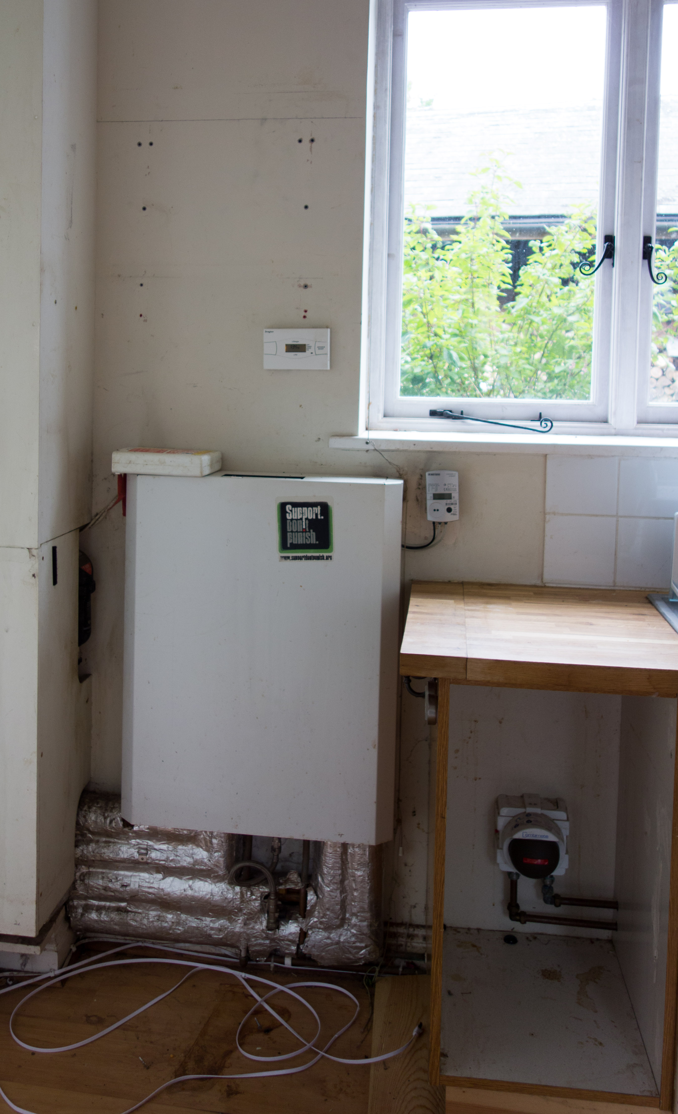
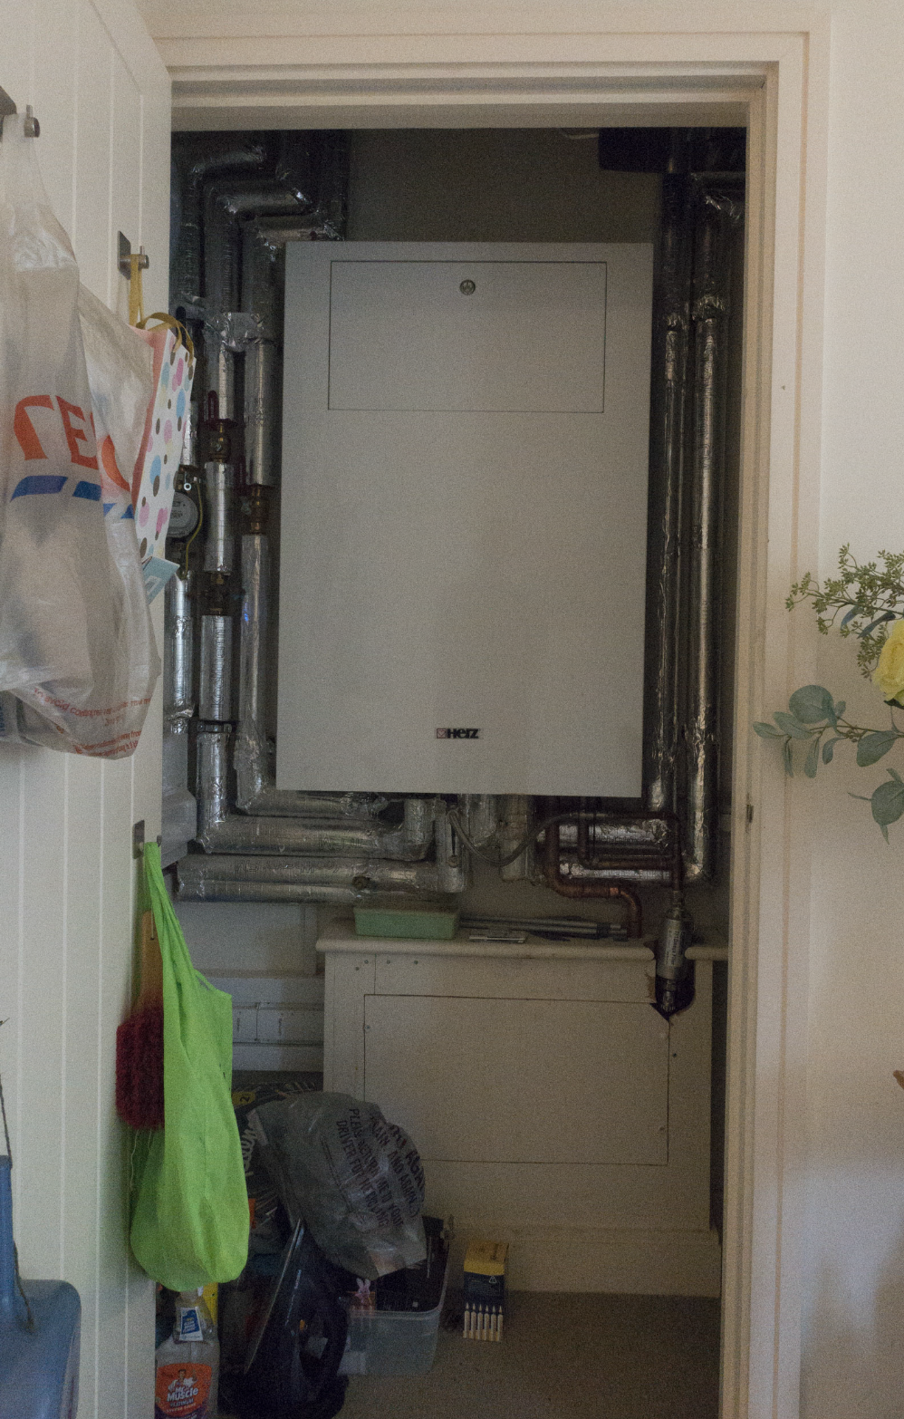
What’s installed in each house?
This box an ‘HIU’ connects the heat network to your existing radiators.
Heating controls would work as they currently do.
It can also connect to your hot water tank
Or
Can produce hot water instantaneously (so you don’t need a hot water tank and get mains pressure hot water (= good showers!)
The heat co-op would own and maintain the HIU.

Slide 14
The temperature of the network will be similar to most houses current heating system. This makes the heat pump less efficient but means far fewer changes needed in each houses.
Each customer has a heat meter that measures the heat each customer uses.
Heat prices will be much more stable as oil and imported electricity use small (most electricity from wind turbine / PV )
The thermal store (big hot water tank) means the heat pump can make lots of extra heat when it’s windy which can then be used later peak demand times and when there is no wind to make cheap electricity.

Slide 15
The case studies showed that:
There was considerable interest with large heat loads in the north of the town (inc the Castle Hotel & Old School House)
Most properties could connect fairly easily to the network using a basement, side passage or rear entry
Some properties however that lack any of these will require extra consideration if they are to join the network
Unfortunately, as most of Enterprise House is heated by heat pumps powered partly by solar panels it’s not initially on our list of potential connections

Slide 16
The economics
Heat networks are expensive – especially the pipes in the ground, (but the pipes do last a long time)
So the challenge is how to afford the high capital cost.
Customers will pay no upfront cost to connect (otherwise few would connect)
A standing charge is paid, and this is set to be a little cheaper than the long-term cost of your oil / LPG boiler (servicing and replacing every 10-15 yr)
The aim is for the heat charge per kWh is a little cheaper than heat from your boiler is. (Currently hard to know what reasonable medium-term oil / LPG costs are.)
As most of the ongoing cost are paying back the loan on the money borrowed future heat cost will be very stable
Heat prices will be set to recover costs and not to make a profit.

